Slide 1
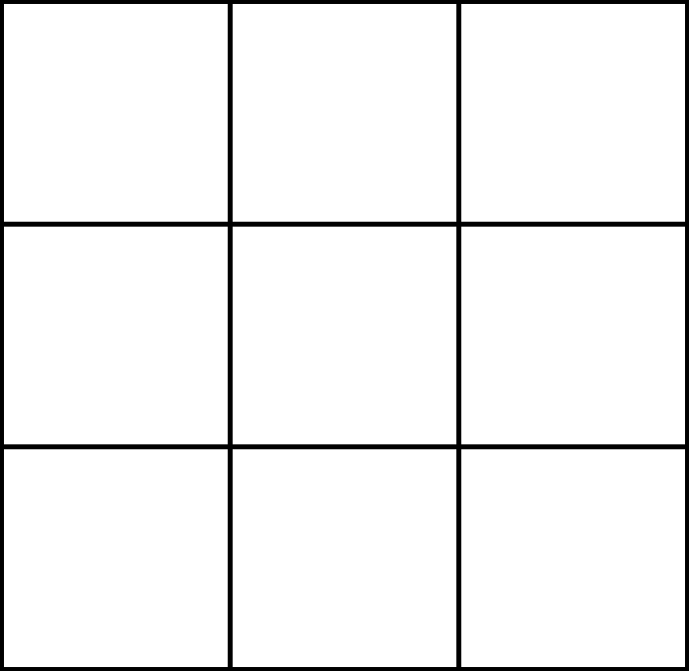
I <3 Sudoku
May Trix is trying to solve this Sudoku, but keeps getting distracted by its heart.
_ _ _ _ _ _ _ _ _ _

Slide 2
Across:
1: Second irregular prime
4: Summer of Love (YY)
5: 2095/5
8: 1011010011₂
9: sqrt(748225)
10. Klein and Szekeres get married as a result of the Happy Ending problem (YY)
12: 5⁴+2*5³+5²-5
13: 2 * 3 * 71
14: [17 Down] * 2
16: DCLXXIV
18: 3 consecutive powers of 3, in descending order
19: 2 * 3³ * 7
21: Neither prime nor composite
22: Second-smallest positive square
23: 3² * 7
25: Love Parade in Berlin originates (YY)
26: Smallest prime
27: Bond. James Bond
28: One Love Peace Concert (YY)
30: The digits of [28 Across] multiplied by each other
31: 9 * 0.999…
33: Pi Day (DD)
35: Whitney Houston releases "I will always love you" (YY)
36: 2 * 11 * 43
38: The number of golden rings my true love gave to me
39: The only prime one less than a perfect cube
Down:
2: 47 * 2
3. (3!)²
5. 2⁹ - 2² * 9 + 2
6: 2 * 3² * 7
7: Happy ending problem generalization proved by Erdos and Szekeres (YYY)
10: 6.533...3 minutes in seconds
11: 9 * [12 Down]
12: Winston Smith falls in love with Julia (YY)
14. (Number of days in 2025)₁₆
15: 3 * 7 * 13
17: Kurt Vonnegut's love letters begin (YY)
20: "I wanna be your lover" - Prince's first hit single released (YY)
23: (2*5)²-2⁵
24: 156.3 inches in cm
28. George Washington gets married (YYY)
29: Radon's atomic number
32: The only prime one less than a perfect square
33: The third number of the Pythagorean triple (8, 15, ?)
34: 41 * 2
37: Twin prime of 41

Slide 3
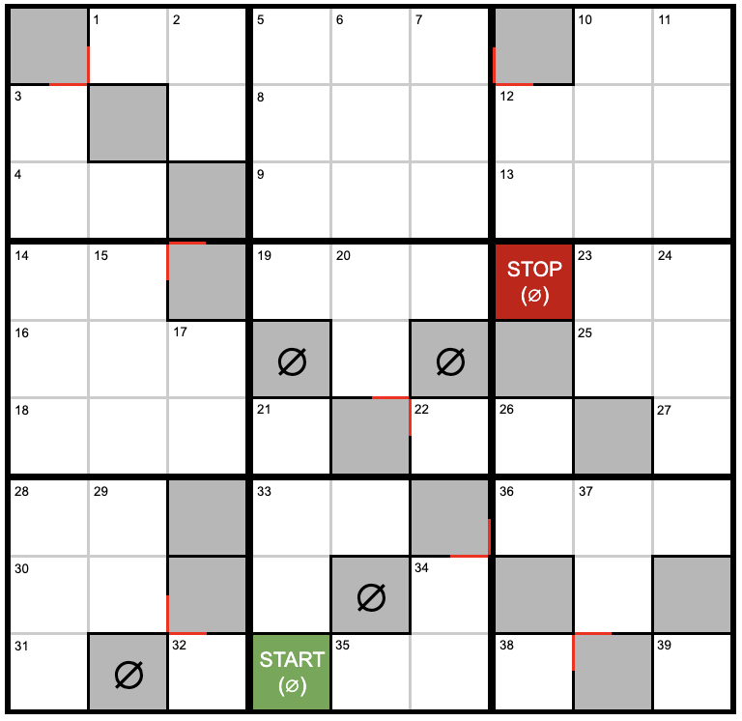
THERE IS AN ERRATA IN THIS PUZZLE - DONT PRINT WITHOUT FIXING

